Slide 1
State Feedback Control Systems
Chapter 6

Slide 2
Review
Definition of controllability
Controllability condition and its demonstration
Controllability canonical form and its controllability

Slide 3
Outlines to this Lesson
Definition of observability
Observability condition and its demonstration
Observability canonical form and its observability
Controllability and Observability versus Zero-Pole Cancellation
Controllability and Observability Decomposition
State-feedback control
Output-feedback control

Slide 4






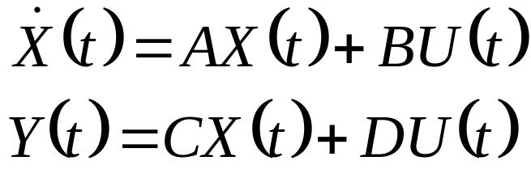
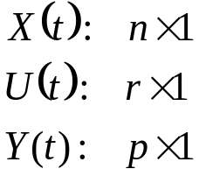
Observability
Definition:
Given a linear time-invariant system that is described by the following
dynamic equations, the state is said to be observable if given
any input , there exists a finite time such that the knowledge
of for ; matrices A, B, C, and D; and the output
for are sufficient to determine . If every state of the system
is observable for a finite , we say that the system is completely
observable, or simply observable.

Slide 5
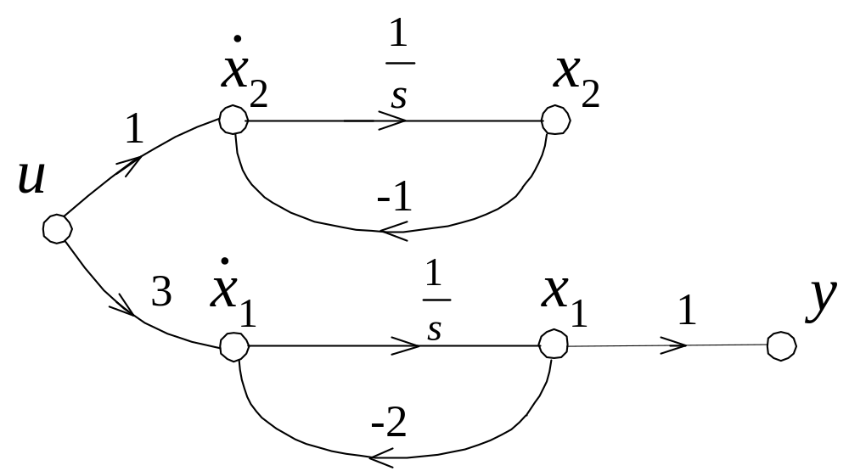


Examples of Unobservable
Example 6.7
Find the given system is observable or unobservable.
x
2
Observable
subspace
x
1
is independent of , system is unobservable.

Slide 6
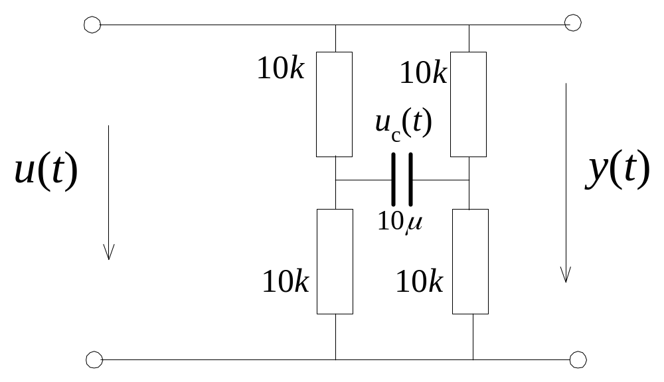


Examples of Unobservable
Example 6.8
Find the given system is observable or unobservable.
does not have any information of , system is unobservable.

Slide 7

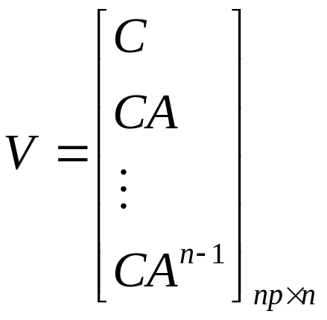
Observability Condition
For the system described by the given state equation
to be completely observable, it is necessary and sufficient that the
following observability matrix V has a rank of n:

Slide 8
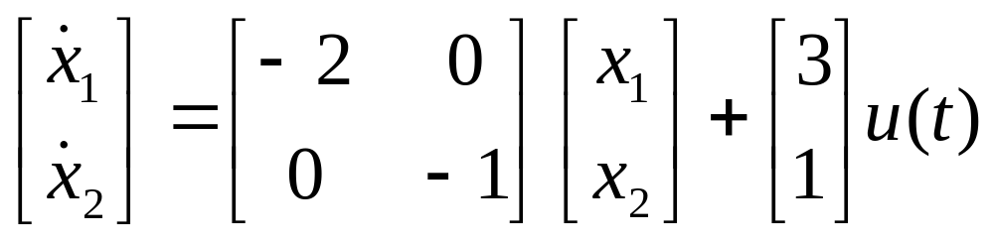
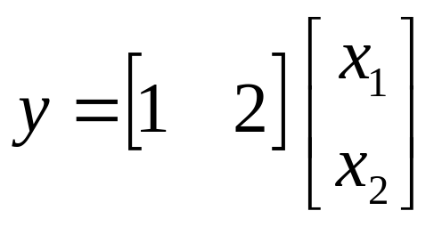
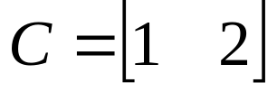
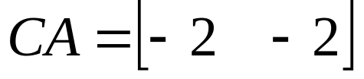
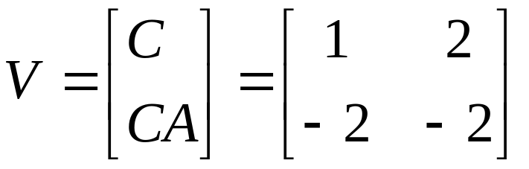
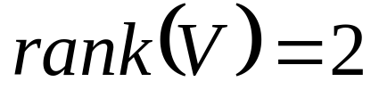
Observability Example
Example 6.9
Find the given system is observable or unobservable.
A:
system is observable

Slide 9
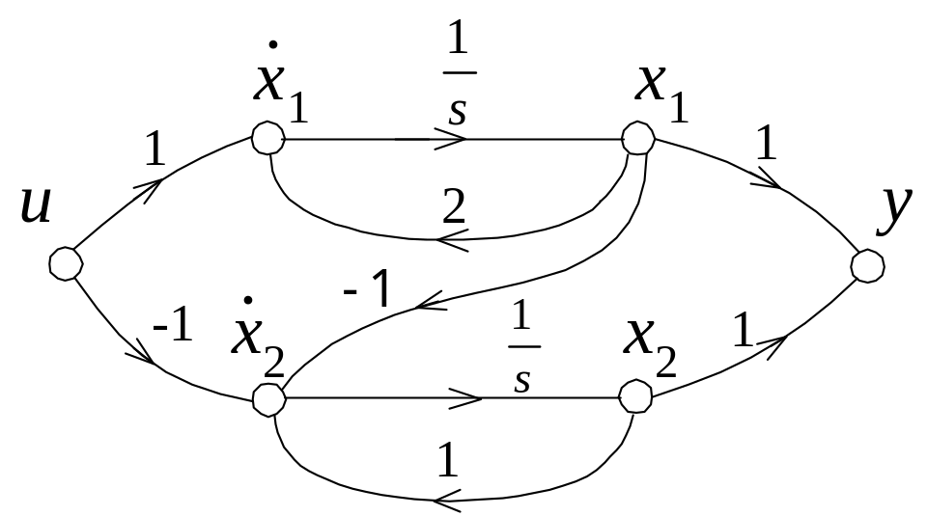
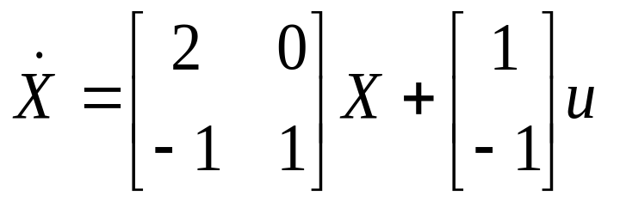
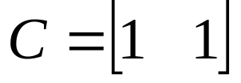
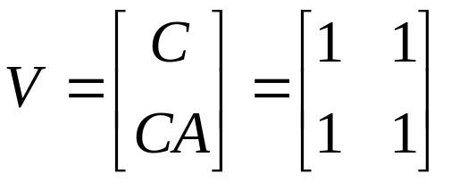
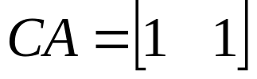
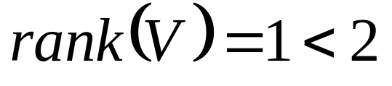
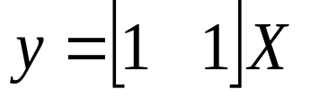
Observability Example
Example 6.10
Find the given system is observable or unobservable.
A:
system is unobservable

Slide 10





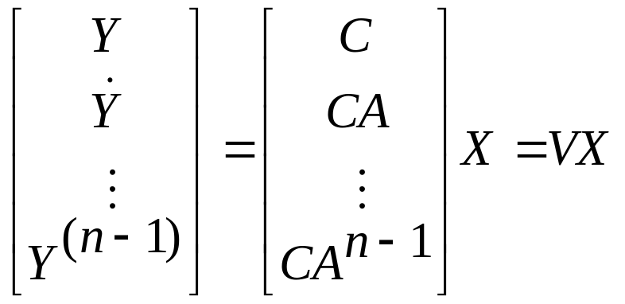
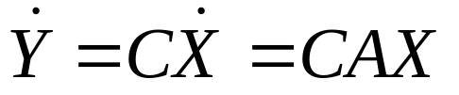
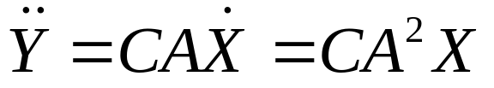

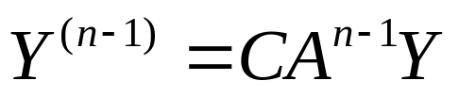
Proof of the Observability Condition
To prove the observability of a system, we need to demonstrate
that by the knowledge of , and , we can determine
.
For a LTI system:
Set

Slide 11
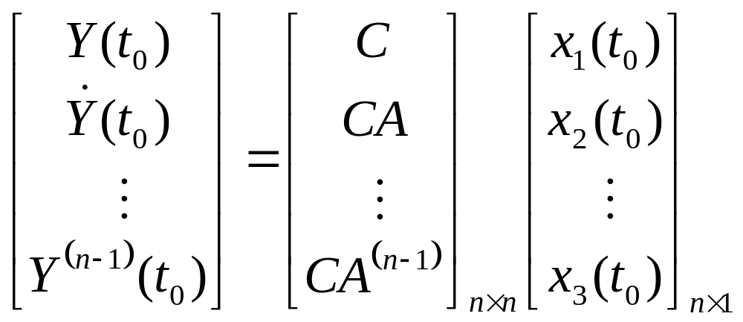


For an single output system:
There are n unknown variables and n equations.
If , the inverse of V exists, the equation has unique solution,
and the system is observable.
If , the inverse of V does not exist,we can not find a unique
solution through the above equation.

Slide 12
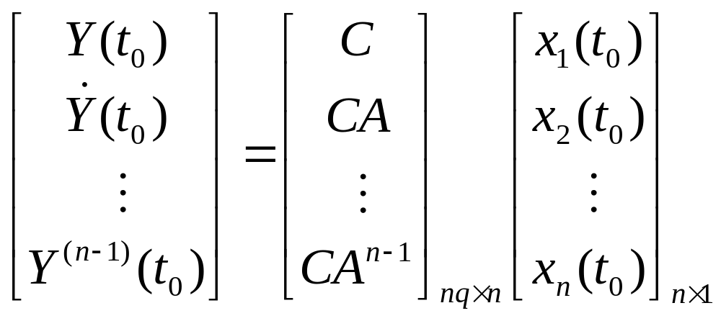


For a multiple-output system, assume there are q outputs:
There are n unknown variables and nq equations.
If , the equations have solutions, and the system is observable.
If , we can not find a unique solution through the above equation.
Observability does not change
after non-singular linear transformation

Slide 13
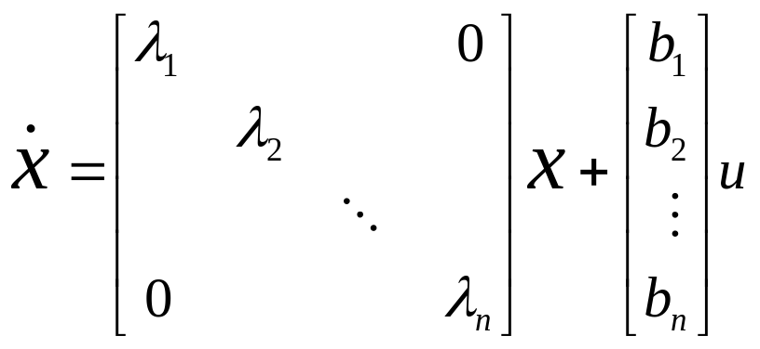
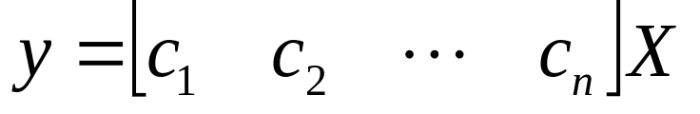
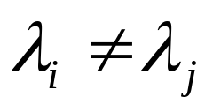
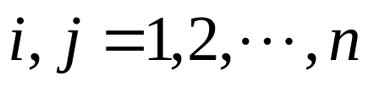
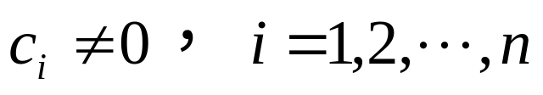
Observability Condition 2
For a linear time-invariant system with distinct eigenvalues to be
observable, it is necessary and sufficient that the C matrix in its
diagonal canonical form does not have a column with all elements to
be zero.
For example:
A single output system
if C does not have any zero element, the system is observable.

Slide 14
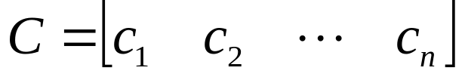
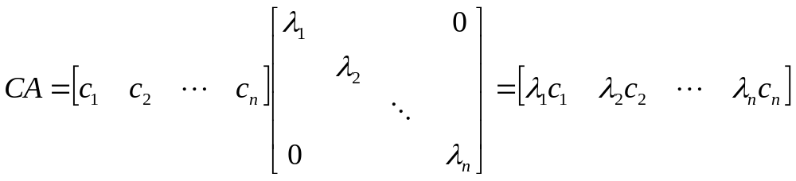
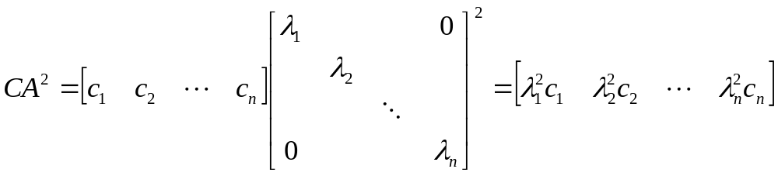
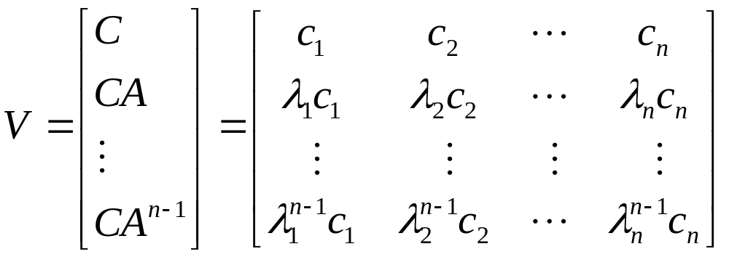



if
then

Slide 15
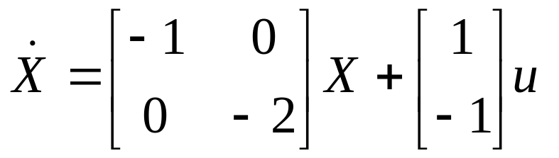
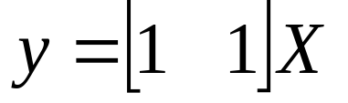
Example 6.11 Use Matlab tools to find out the observability of
the give system.
A:
a=[-1 0;0 -2]
c=[1 1]
v=[c ; c*a]
rank (v)
v=
1 1
-1 -2
rank (v)=2

Slide 16
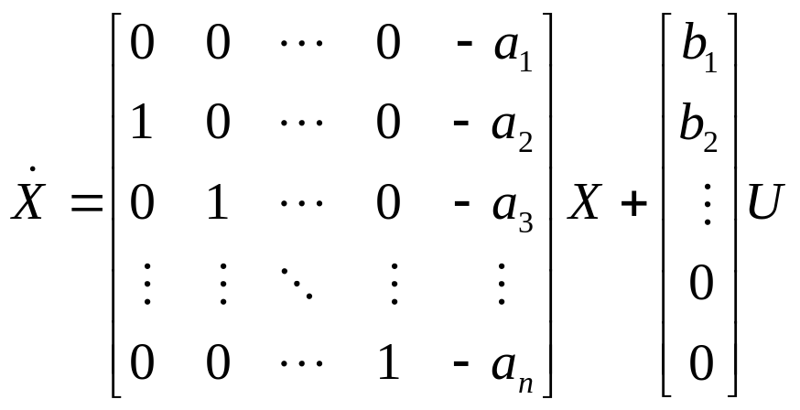

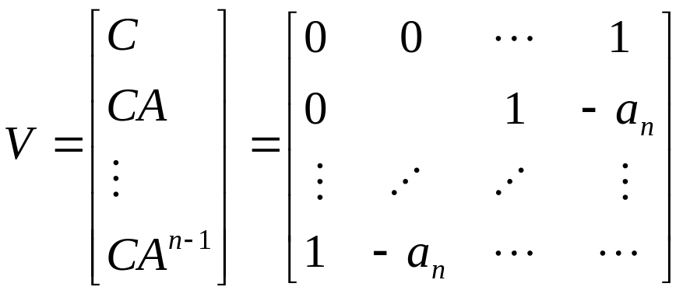
Observability Canonical Form
Systems in Observability canonical form must be observable.

Slide 17
Controllability and Observability versus Zero-Pole Cancellation
Why can a transfer function always be transformed into
a state space model in CCF or OCF?
Notes:
factorization

Slide 18
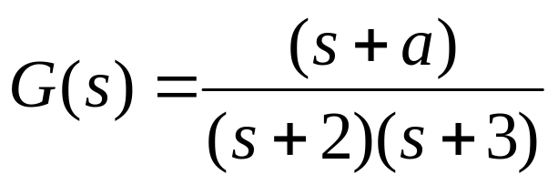
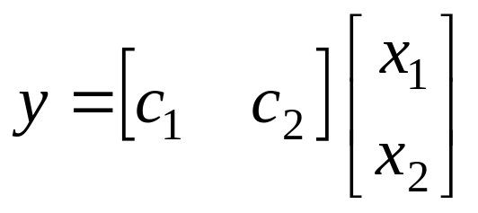
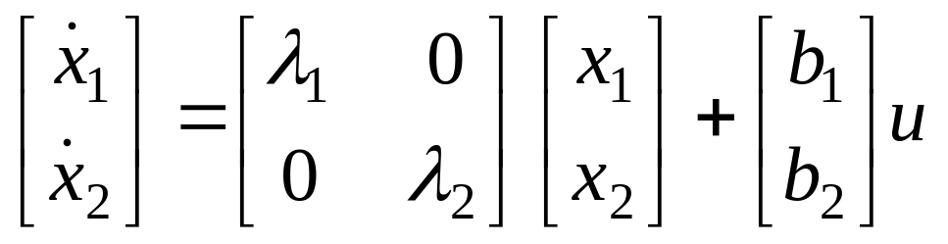
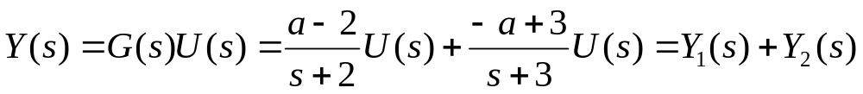
Controllability and Observability versus Zero-Pole Cancellation
Example 6.12 Please convert the transfer function of the given
system into diagonal canonical form, then discuss its controllability
and observability.
A:
Notes:
factorization

Slide 19
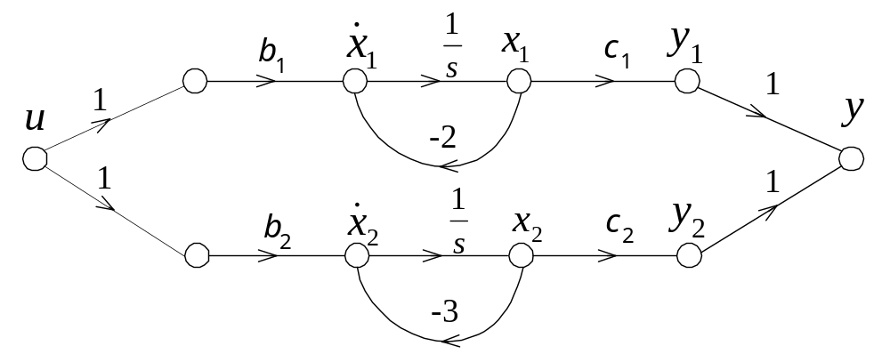
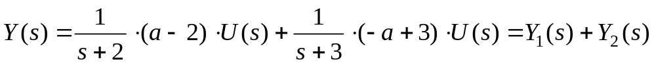
Controllability and Observability versus Zero-Pole Cancellation
Notes:
factorization

Slide 20
Controllability and Observability versus Zero-Pole Cancellation
Notes:
factorization

Slide 21
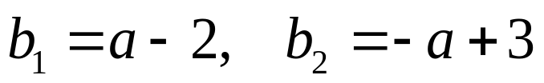


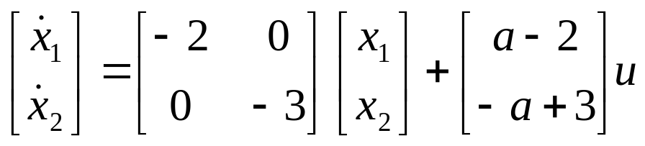
If
when
system is both controllable
and observable

Slide 22

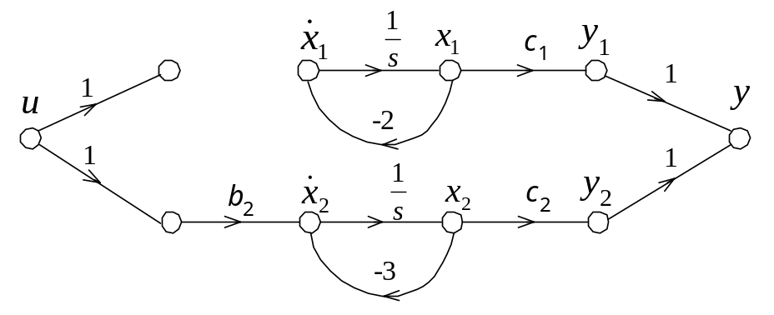
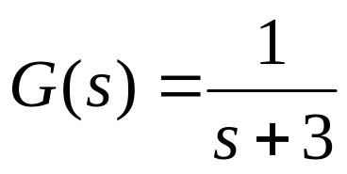
If
uncontrollable

Slide 23

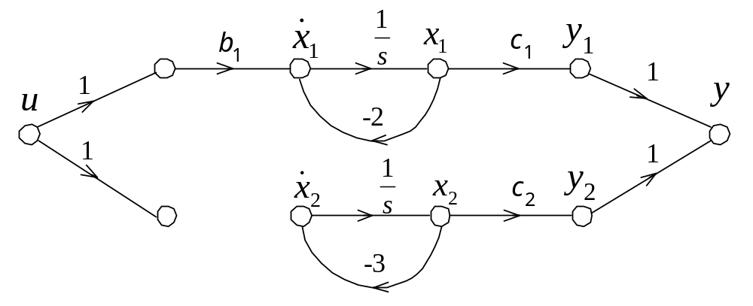
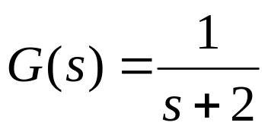
If
uncontrollable

Slide 24

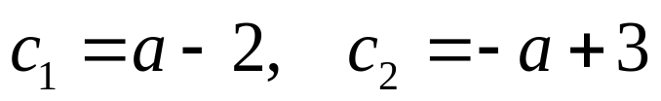


If
when
system is both controllable
and observable

Slide 25

If
unobservable

Slide 26

If
unobservable

Slide 27





If choose
and
then
and further

Slide 28




neither controllable
nor observable

Slide 29

Remarks
For a SISO system (A, B, C) to be controllable and observable, it is sufficient and necessary that its transfer function does not have zero-pole cancellation.

Slide 30
Remarks
In the transfer function of a SISO system, a cancelled pole could relate to an uncontrollable, or an unobservable, or an uncontrollable and unobservable mode. The transfer function only depicts the controllable and observable modes.

Slide 31
Controllability and Observability Decomposition
U
Y
＋
controllable & observable
＋
controllable & unobservable
uncontrollable & observable
uncontrollable & unobservable

Slide 32



Controllability and Observability Decomposition
For a LTI system (A, B, C), rank(S) = m < n , there must exist a
linear non-singular transformation P, X=PX’, which can transform
the system into a new one (A’,B’,C’) that explicitly comprise a
controllable part and an uncontrollable part.
controllable states
uncontrollable states

Slide 33



Controllability and Observability Decomposition
How to construct the linear non-singular transformation P ?
where:
are m linearly independent columns in S
are n-m linearly independent columns in R^{n},
which are also independent of p₁,…,p_{m}.

Slide 34





Example – 6.13
rank(S) = 2 < 3，
System is uncontrollable

Slide 35



⎡
0
0
1
⎤
⎡
−
2
1
−
1
⎤
⎡
0
−
1
0
⎤
⎡
0
0
1
⎤
⎡
0
⎤
⎢
⎥
⎢
⎥
⎢
⎥
X
′
⎢
⎥
⎢
⎥
=
−
1
0
0
0
−
2
0
0
0
1
+
−
1
0
0
0
u
⎢
⎥
⎢
⎥
⎢
⎥
⎢
⎥
⎢
⎥
⎢
0
1
0
⎥
⎢
1
−
1
0
⎥
⎢
1
0
0
⎥
⎢
0
1
0
⎥
⎢
1
⎥
⎣
⎦
⎣
⎦
⎣
⎦
⎣
⎦
⎣
⎦

Slide 36




Controllability and Observability Decomposition
For a LTI system (A, B, C), rank(V) = m < n , there must exist a
linear non-singular transformation Q, X=QX’, which can transform
the system into a new one (A’,B’,C’) that explicitly comprise an
observable part and an unobservable part.
observable states
unobservable states

Slide 37



Controllability and Observability Decomposition
How to construct the linear non-singular transformation Q ?
where:
are m linearly independent rows in V
are n-m linearly independent rows in R^{n},
which are also independent of q₁,…,q_{m}.

Slide 38





Example
rank(V) = 2 < 3，
System is unobservable

Slide 39



⎡
1
−
1
1
⎤
⎡
1
2
−
1
⎤
⎡
3
−
1
−
1
⎤
⎡
1
−
1
1
⎤
⎡
0
⎤
⎢
⎥
⎢
⎥
⎢
⎥
′
⎢
⎥
⎢
⎥
=
2
3
2
0
1
0
2
−
1
0
X
+
2
3
2
0
u
⎢
⎥
⎢
⎥
⎢
⎥
⎢
⎥
⎢
⎥
⎢
0
0
1
⎥
⎢
1
−
4
3
⎥
⎢
0
0
1
⎥
⎢
0
0
1
⎥
⎢
1
⎥
⎣
⎦
⎣
⎦
⎣
⎦
⎣
⎦
⎣
⎦

Slide 40


Controllability and Observability Decomposition
If a LTI system (A, B, C) is neither controllable nor observable,
there must exist a linear non-singular transformation P, X=PX’,
which can transform the system into a new one (A’,B’,C’) that
has the following form:
Controllable & observable
Controllable & unobservable
Uncontrollable & observable
Uncontrollable & unobservable

Slide 41




State-Feedback Control
Instead of using controllers with fixed configurations in the forward
or feedback path, control is achieved by feeding back the state
variables through real constant gains.
SISO:
state feedback gain
If choose:
where
.
r
t
u
X
t
u
t
(
)
(
t
X
t
(
)
(
)
)
(
)
y
y
t
(
t
(
)
+
+
)
B
∫
C
+
∫
-
+
A
K
T

Slide 42


Pole-Placement Design through State Feedback
Knowing the relation between the closed-loop poles and the system
performance, we can effectively carry out the design by specifying
the location of these poles.
Theorem: For a SISO system (A,B,C), if its poles can be arbitrarily
placed, it is a sufficient and necessary condition that the system is
controllable.
Proof:
sufficiency
If a system is controllable, it can be transformed into CCF

Slide 43



Introducing state feedback:

Slide 44



Slide 45


n arbitrary poles can determine n coefficients.
Adjust coefficients
of Characteristic
Equation of the CLS.
System is Controllable
CCF
Poles of CLTF

Slide 46

Necessity:
If the system is uncontrollable, it must have uncontrollable states.
The poles corresponding to these states can’t be arbitrarily placed.
U can’t affect

Slide 47


How to determine the Feedback Gain ?
Method of undetermined coefficient:
Step 1:
Substitute
into the state equation
Characteristic equation:
Step 2:
Calculate the characteristic equation of the desired system
Step 3:
Compare the two characteristic equations:

Slide 48




Example – 6.14
Q: Giving a system with the following state equation, please find
the feedback gain that can make the poles of the modified system
at
A:
check the controllability of the original system
system is controllable, so its poles can be arbitrarily placed.

Slide 49




The characteristic equation after introducing state feedback:
The characteristic equation of the desired system:
Compare the above two equations, we get:

Slide 50


The original system:
The state feedback gain:

Slide 51
Step Response
0.5
a=[0 1;-2 -3];
b=[0;1];
c1=[1 0];
c2=[0 1];
d=0;
g1=ss(a,b,c1,d);
g2=ss(a,b,c2,d);
step(g1,g2)
0.45
x
0.4
1
0.35
0.3
Amplitude
0.25
0.2
0.15
0.1
x
2
0.05
0
0
1
2
3
4
5
6
Time (sec)

Slide 52


Slide 53





Example – 6.15
Q: Given a system with the following state equation, please find
a feedback gain that can make the poles of the modified system
at ,
A:
check the controllability of the original system
system is controllable, so its poles can be arbitrarily placed.

Slide 54


The characteristic equation after introducing state feedback:

Slide 55


The characteristic equation of the desired system:
Compare the above two equations, we get:

Slide 56


The original system:
The state feedback gain:

Slide 57

投票
最多可选1项
Can state feedback change the controllability of a system?
A
Yes
B
No
提交

Slide 58




State Feedback and Controllability
State feedback can not change the controllability of a system
r
t
u
X
t
u
t
(
)
(
t
X
t
(
)
(
)
)
(
)
y
y
t
(
t
(
)
+
+
)
B
∫
C
+
∫
-
+
A
K
T

Slide 59






The controllability matrix of the original system:
The controllability matrix of the compensated system:
Notice that the double underscored is real numbers. So each column
of can be linearly represented by the columns of . Therefore:

Slide 60
投票
最多可选1项
Can state feedback change the observability of a system?
A
Yes
B
No
提交

Slide 61
State Feedback and Observability
Can state feedback change the observability of a system?
Because the system poles can be arbitrarily placed through state
feedback, when a replaced pole cancels a zero, the system
observability will be changed.

Slide 62
投票
最多可选1项
Will state feedback change the order of a system?
A
Yes
B
No
提交

Slide 63
State Feedback and Observability
Will state feedback change the order of a system?
State feedback will not change the order of a system.
Introducing state feedback:

Slide 64


Output Feedback
Control is achieved by feeding back the outputs through real constant gains.
SISO:
output feedback gain
If choose:
where
.
r
t
u
X
t
u
t
(
)
(
t
X
t
(
)
(
)
)
(
)
y
y
t
(
t
(
)
+
+
)
B
∫
C
+
∫
-
+
A
k

Slide 65

Output Feedback
R(s)
Y(s)
+
G(s)
-
k

Slide 66


General Conclusions about Output Feedback
If a SISO system is both controllable and observable, after introducing the output feedback, the new system is also controllable and observable.
When there is not output feedback:
Because the system is both controllable and observable, there
is no common factor in numerator and denominator.
When there is output feedback:
there is no common factor in numerator and denominator either.
So, there is no zero-pole cancellation.

Slide 67


General Conclusions about Output Feedback
If a SISO system is uncontrollable ( unobservable), after introducing the output feedback, the new system is still uncontrollable ( unobservable).
There exists zero-pole cancellation in
When there is output feedback:
The common factors don’t change, zero-pole cancellation does
not disappear.

Slide 68
Wrap-up
Definition of observability
Observability condition and its demonstration
Observability canonical form and its observability
Controllability and Observability versus Zero-Pole Cancellation
Controllability and Observability Decomposition
State-feedback control
Output-feedback control

Slide 69

Assignment
Page 150
3， (3)、(4)
Page 150~151
6
9，(1)

